Slide 1
AEM as Cloud Service Overview
Vishawdeep Dhaliwal

Slide 2

Contents
Top Features/Notable changes
No custom runmodes
No Classic UI
Storage in Cloud
Content Publishing process
Built in CDN
Product Update/Release cycle
Release validator
Release Orchestrator
Troubleshooting
How to check Logs
Developer Console
Local Developer Setup
AEM Support Sandbox

Slide 3
Custom runmodes are not allowed
Out of the box runmodes :
author
publish
prod
author.prod
publish.prod
stage
author.stage
publish.stage
dev
author.dev
publish.dev
9
DX CRM Systems
Now

Slide 4
No classic UI
Classic UI is finally removed for AEM Cloud
No more ExtJS based editor (Sites & Assets)
No more ClientContext due to classic UI dependencies
https://opensource.adobe.com/aem-modernize-tools/
9
DX CRM Systems
Now

Slide 5
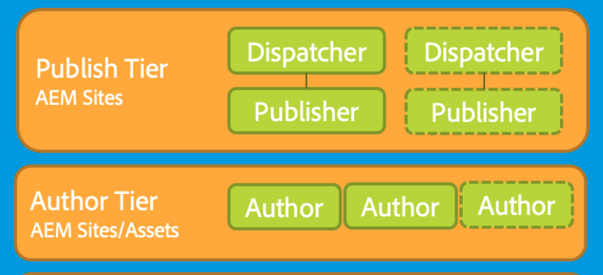
Storage in Cloud
Shared Binary Storage via Azure Blobstore with Direct Binary Access.
Author:
Cluster with Shared Document Nodestore (Mongo) continuous use across deployments
Publish:
Publish nodes with dispatcher
Azure segment Store
9
DX CRM Systems
Now

Slide 6
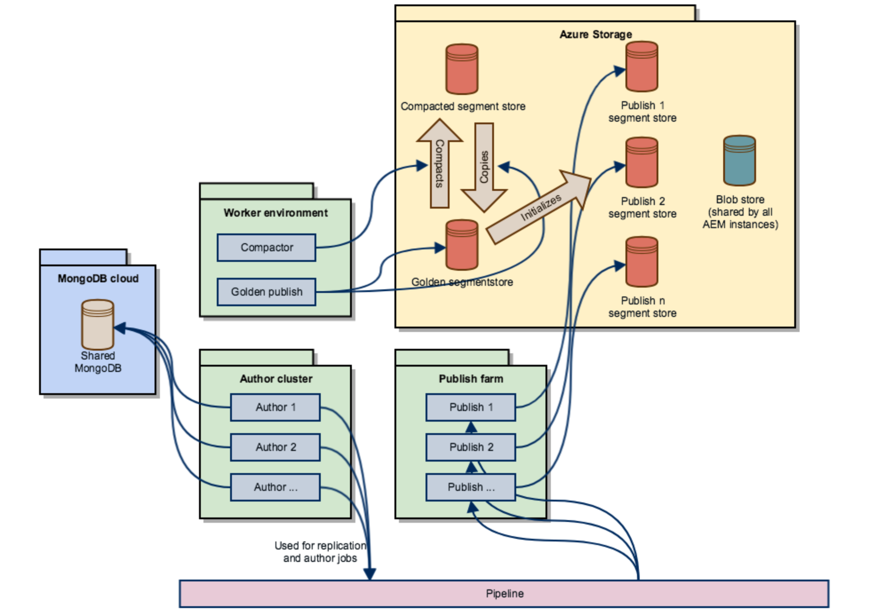
Golden publish
Not accessed by any end user
SegmentNode repository using Blob storage
9
DX CRM Systems
Now

Slide 7
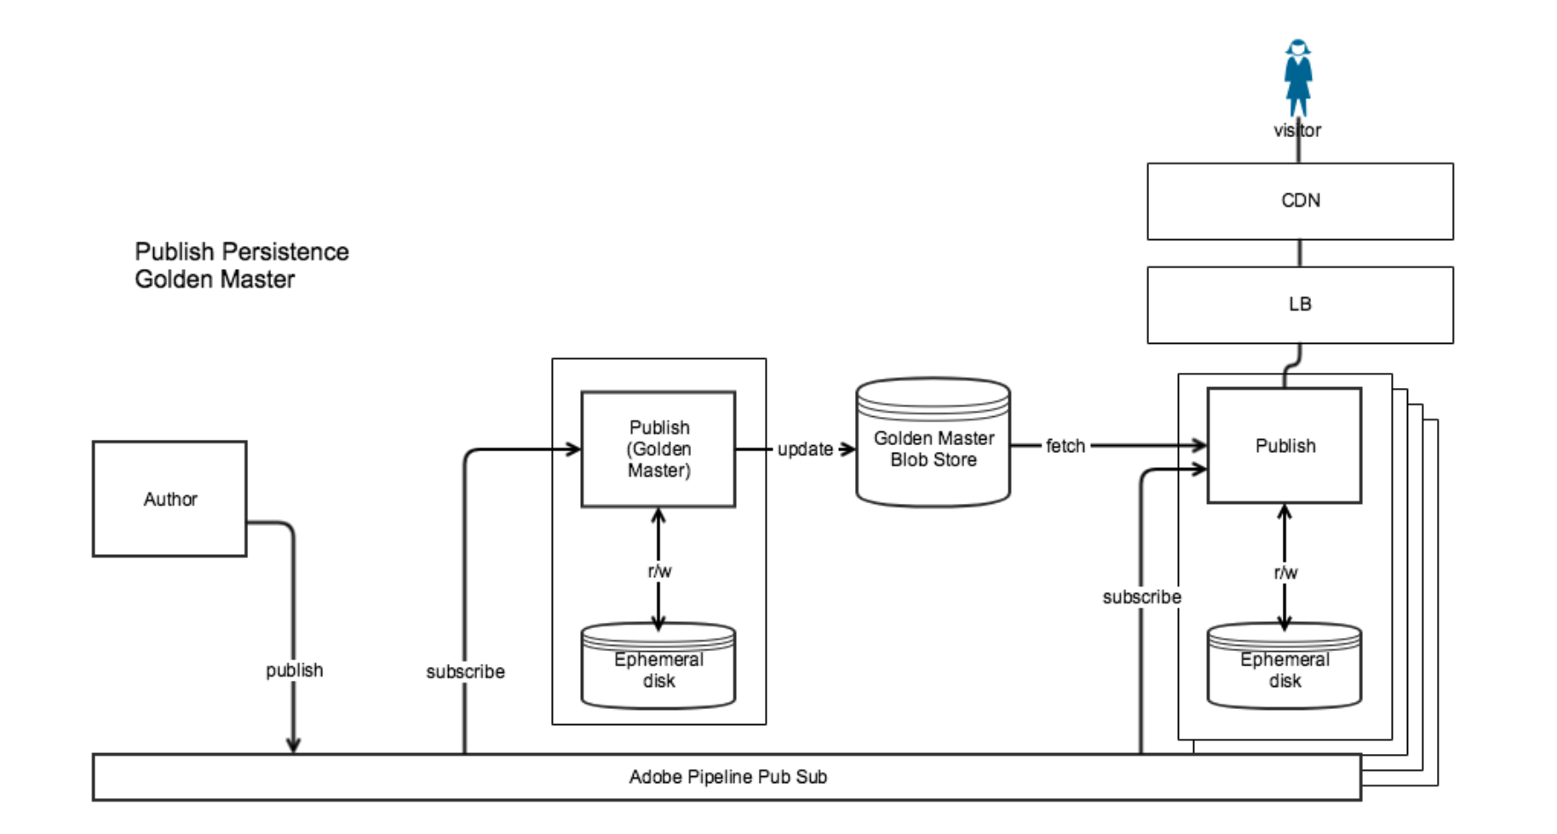
Content Publishing process
Replication framework is no longer used.
Uses the Sling Content Distribution
Uses a pipeline service run on Adobe I/O, which is outside the AEM runtime.
Classic Replication UI removed
9
DX CRM Systems
Now

Slide 8
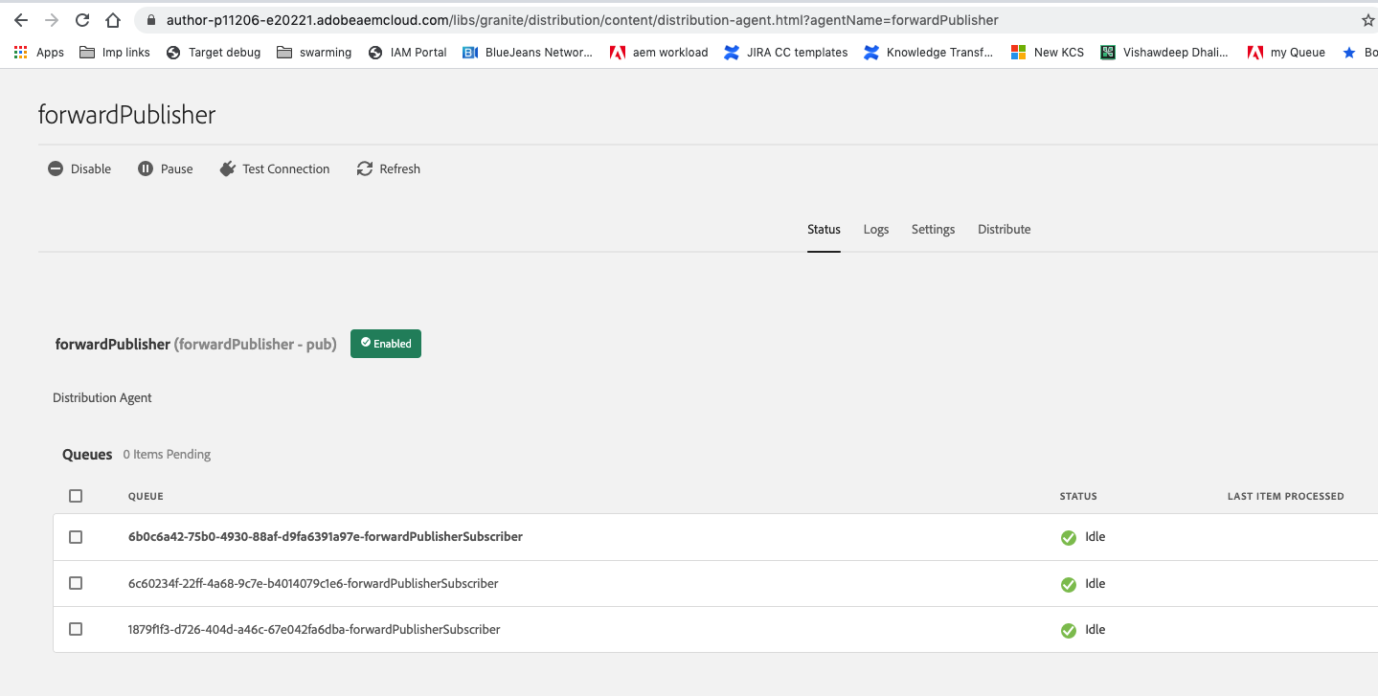
Content Publishing process
Tools > Deployment > Distribution : Select the card forwardPublisher
9
DX CRM Systems
Now
https://wiki.corp.adobe.com/display/DMSArchitecture/KT+-+AEM+Cloud+Service+-+Understanding+how+Publishing+Content+works

Slide 9
CDN
AEM Managed CDN
built-in CDN -> Fastly
Automatically provisioned and configured
Managed by Adobe
Optimized by Adobe
Customer Managed CDN
Customer is responsible for configuration
Customer’s CDN points to Adobe Managed CDN
9
DX CRM Systems
Now

Slide 10
Product Update/Release cycle
Daily releases
Monthly feature releases
Release validator
Validate new releases
Release Orchestrator
Service that handles upgrading of customers to a new AEM release
Rollback customers to a previous version
Dashboard:
https://dashdiscovery.corp.adobe.com/#/views/ReleaseOrchestratorOverview/Dashboard?:iid=1
https://dashdiscovery.corp.adobe.com/#/views/CloudManagerUsage/CICDDashboard?:iid=1
Jenkins: https://jenkins-evergreen.bsl.eur.adobe.com/job/evergreen-skyline-release-orchestrator/
9
DX CRM Systems
Now

Slide 11
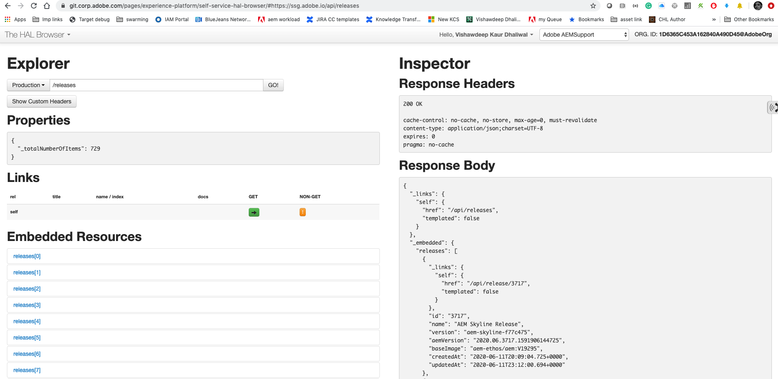
Product Update/Release cycle
Hal browser: https://git.corp.adobe.com/pages/experience-platform/self-service-hal-browser/#https://ssg.adobe.io/api/releases
9
DX CRM Systems
Now

Slide 12
Troubleshooting Issues in Cloud

Slide 13
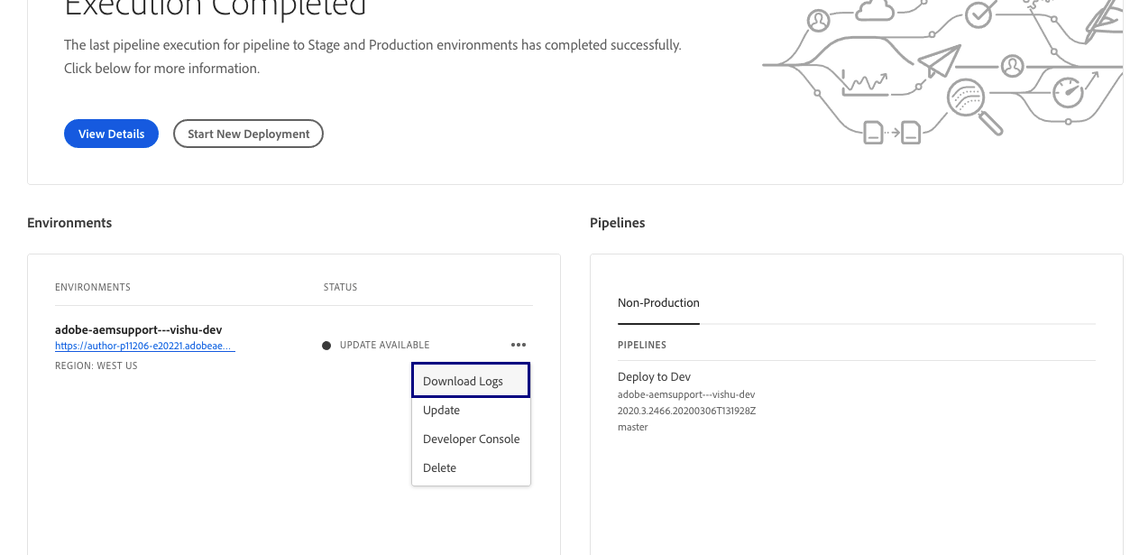
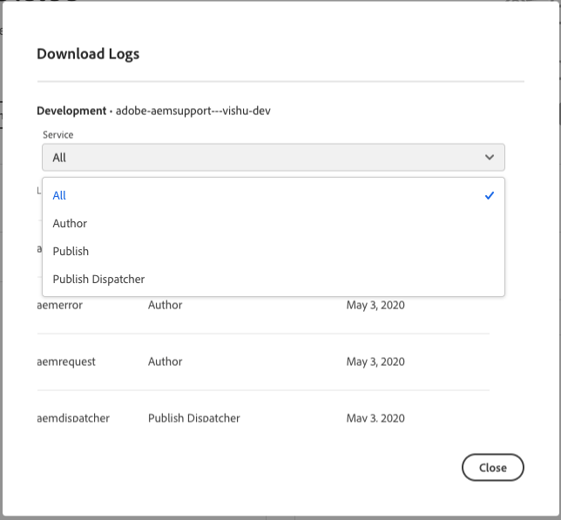
Access Logs
Cloud Manager UI
Download logs - publish_aemerror_2020-05-03.log
9
DX CRM Systems
Now

Slide 14
Access Logs
Cloud Manager plugin for the Adobe I/O CLI
Steps to setup CM plugin:
https://github.com/adobe/aem-enablement/tree/master/AEMAsACloudService/11_CloudManager_AIO
Execute commands
https://github.com/adobe/aio-cli-plugin-cloudmanager
aio cloudmanager:download-logs ENVIRONMENT_ID SERVICE NAME
aio cloudmanager:download-logs ENVIRONMENT_ID SERVICE NAME DAYS
aio cloudmanager:download-logs --programId=PROGRAM_ID ENVIRONMENT_ID SERVICE NAME DAYS
aio cloudmanager:tail-log ENVIRONMENT_ID SERVICE NAME
aio cloudmanager:tail-log --programId=PROGRAM_ID ENVIRONMENT_ID SERVICE NAME
Example: aio cloudmanager:download-logs --programId 5 1884 author aemerror
9
DX CRM Systems
Now

Slide 15
Access Logs
Using Splunk
Navigate to https://splunk.or1.adobe.net/en-US/app/TA-aem_skyline/aem_logs
Select the AEM Service name, for example cm-p12345-e0987, where P is ProgramID and E is Environment ID.
P and E values can be extracted from customer's instance URL.
author-p<id>-e<id>.adobeaemcloud.com
Publish-p<id>-e<id>.adobeaemcloud.com
Example: https://author-p11206-e20221.adobeaemcloud.com/
9
DX CRM Systems
Now

Slide 16
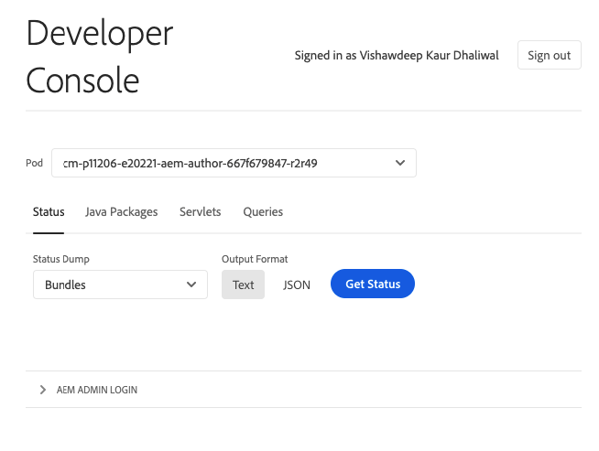
Developer Console
Generate the state of bundles, components, OSGI configurations, oak indexes, OSGI services, and Sling jobs.
Resolve package dependencies and servlets.
Link to the Explain Query tool.
9
DX CRM Systems
Now

Slide 17
Local Developer setup
Local SDK currently based on QuickStart
Updates via maven
Download from Software distribution: https://experience.adobe.com/#/downloads/content/software-distribution/en/aemcloud.html
Steps: https://github.com/adobe/aem-enablement/tree/master/AEMAsACloudService/07_Cloud_Ready_Quickstart
Support Sandbox
https://experience.adobe.com/#/@aemsupport/cloud-manager/landing.html
https://wiki.corp.adobe.com/display/WEM/Skyline+Sandbox+Environments+-+Getting+Started
https://docs.adobe.com/content/help/en/experience-manager-cloud-service/implementing/developing/aem-as-a-cloud-service-sdk.html
https://docs.adobe.com/content/help/en/experience-manager-learn/cloud-service/local-development-environment-set-up/overview.html
9
DX CRM Systems
Now

Slide 18
References
https://opensource.adobe.com/aem-modernize-tools/
https://wiki.corp.adobe.com/display/DMSArchitecture/KT+-+AEM+Cloud+Service+-+Understanding+how+Publishing+Content+works
https://wiki.corp.adobe.com/pages/viewpage.action?spaceKey=~boston&title=AEM+in+the+Cloud+-+Architecture
https://git.corp.adobe.com/asaar/6pager/blob/master/Bill-Visit-Feb18/AEM-Foundation-Cloud-Readiness.md
https://docs.adobe.com/content/help/en/experience-manager-learn/cloud-service/local-development-environment-set-up/overview.html
9
DX CRM Systems
Now

